Slide 1

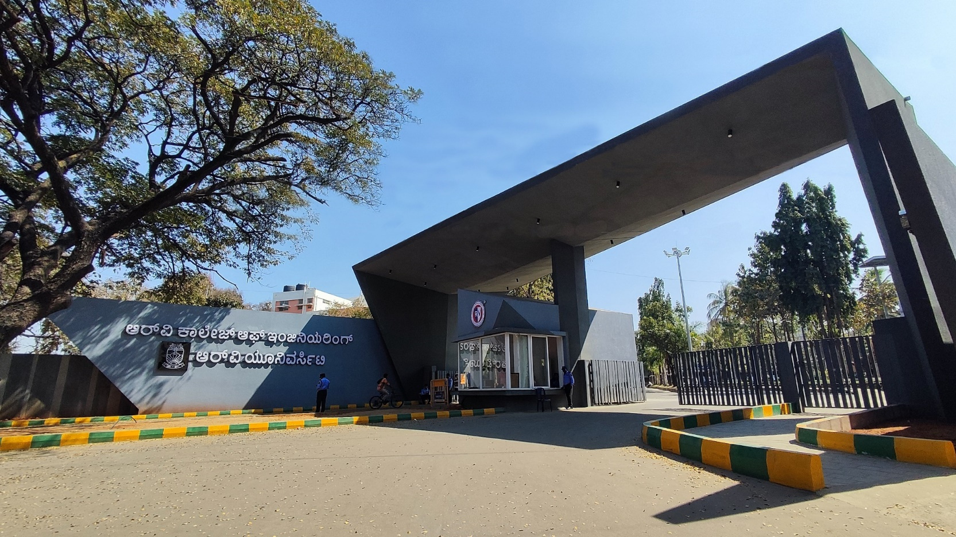
Hybrid MMAS-ABC for Sustainable Bus Optimization
Urban Development, Mobility & Smart Cities Project no: 49
Tuesday, 16 December 2025
Go, change the world
1

Slide 2
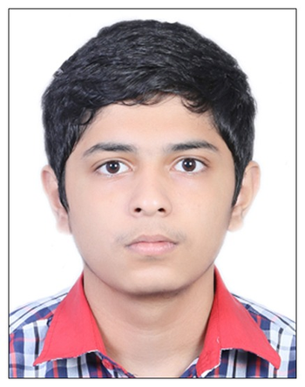



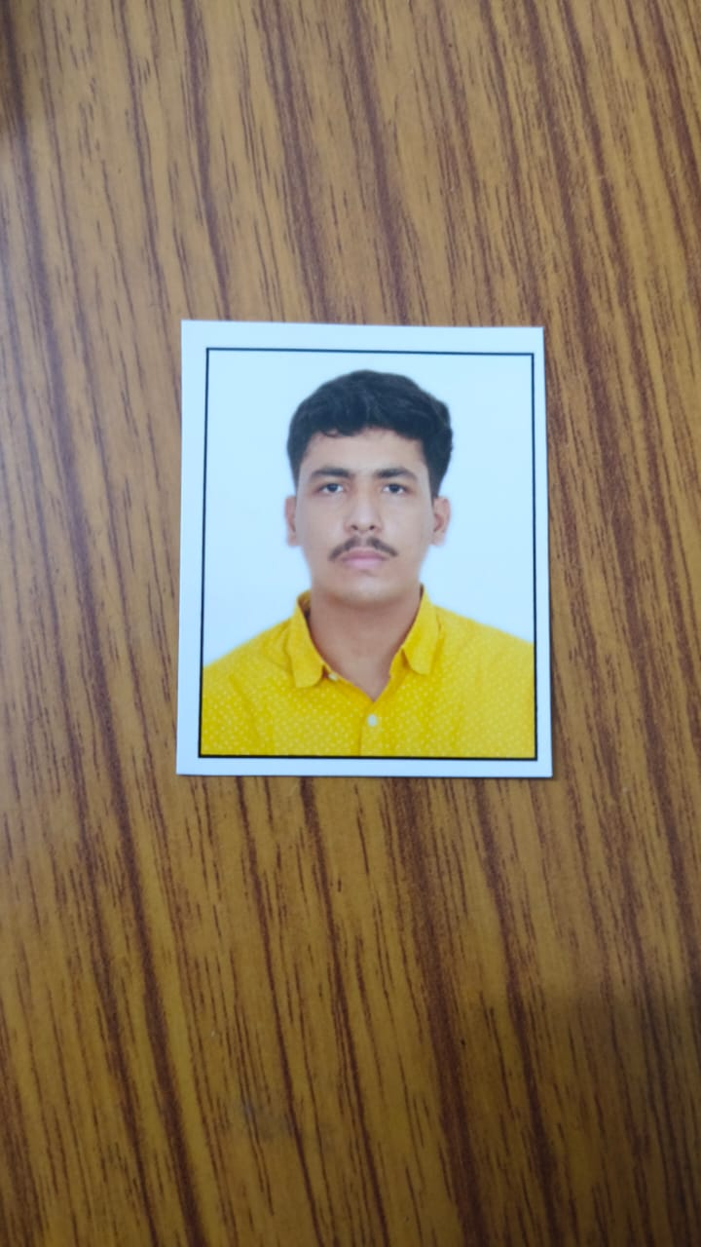

Hybrid MMAS-ABC for Sustainable Bus Optimization
K Karthik Pai
Manik Kanyal
Manas Saxena
Dr. Gangadhar Angadi
Assistant Professor
Mechanical Engineering
Aryaman Pandey
Aditya Mishra
Tuesday, 16 December 2025
Go, change the world
2

Slide 3
EL Phase-III Presentation Outline
Introduction
Project Overview
Comments during EL Phase-I and action taken.
Methodology
Tools and Techniques Used
Project Progress
Analysis of Partial Results
Results and Discussion
Conclusion
Outcome of the work
Tuesday, 16 December 2025
Go, change the world
3

Slide 4
INTRODUCTION
Overview of the topic:
Utilizes real-life bus data and hybrid MMAS-ABC algorithms to generate driving cycles, accurately quantifying emissions and identifying congestion hotspots.
Leverages these validated insights to optimize EV deployment and route planning, making urban transport systems smarter and more sustainable.
Objectives of the current phase:
Utilize the Phase 2 model to generate driving cycles, calculating CO2 emissions and fuel savings to identify efficient bus routes.
Pinpoint congestion hotspots and validate the model's accuracy using Root Mean Square Error (RMSE).
Apply findings to strategize optimal Electric Vehicle (EV) deployment for sustainable urban transport.
Tuesday, 16 December 2025
Go, change the world
4

Slide 5
Project Overview
Problem Statement
Indian cities suffer from a critical lack of localized driving cycles, making it difficult to accurately estimate emissions and fuel usage for real-world traffic conditions.
Current strategies for bus routing and Electric Vehicle (EV) deployment often lack a scientific, data-driven framework, leading to operational inefficiencies and suboptimal resource use.
Primary Objectives & Relevance
Route Simulation: Generate realistic driving cycles for the Ahmedabad-Gandhinagar route using the hybrid MMAS-ABC algorithm.
Impact Assessment: Quantify emission reductions and identify congestion hotspots, validated via RMSE for high model accuracy.
Strategic Application: Utilize findings to optimize Electric Vehicle (EV) deployment and improve sustainable route planning.
.
Tuesday, 16 December 2025
Go, change the world
5

Slide 6
Expected Impact or Contribution
Enables accurate identification of EV-suitable routes, fuel usage patterns, and congestion hotspots for better decision-making.
Supports India’s net-zero goals through reduced emissions and the first MMAS-ABC application for Indian bus driving cycles
Improves long-term transport planning by offering a scalable model that other Indian cities can adopt for fleet optimization and emission reduction.
Provides a scientific basis for policy decisions on public transport electrification, congestion management, and sustainable mobility initiatives.
Tuesday, 16 December 2025
Go, change the world
6

Slide 7
Comments during EL Phase-2 and action taken
Feedback: Requested visualization of interpreted outputs (fuel, congestion) over raw data.
Key Focus: Shifted priority to data interpretation and model validation.
Action Taken: Implemented Python logic to process metrics and visualize findings.
Improvement: Enhanced Website UI to display validated, actionable insights.
Tuesday, 16 December 2025
Go, change the world
7

Slide 8
Methodology
Data Acquisition: Collection of high-resolution GPS logs (Ahmedabad/BMTC).
Preprocessing: Python-based noise filtering and kinematic smoothing.
Optimization: Two-stage algorithmic process to minimize fuel waste.
Project Milestones:
Data Collection → Algorithm Development → Model Validation → Web Deployment.
Tuesday, 16 December 2025
Go, change the world
8

Slide 9
Tools and Techniques Used
Tools, Technologies & Techniques Used
Core Logic: Python 3.9 with pandas & numpy for heavy data processing.
Visualization: Matplotlib for generating velocity profiles and congestion graphs.
Geospatial: Geopy for precise distance calculations between GPS coordinates.
Rationale for Choosing These Tools
Matplotlib: Enables clear, scientific visualization of driving cycles and emission trends.
Geopy: Essential for accurate distance metrics on the Ahmedabad-Gandhinagar route where GPS data can be noisy.
Innovative or Cutting-Edge Aspects
Visual Analytics: Direct translation of raw logs into intuitive velocity and emission plots.
Precision: High-fidelity spatial tracking ensures the MMAS-ABC algorithm works on accurate real-world distances.
Tuesday, 16 December 2025
Go, change the world
9

Slide 10
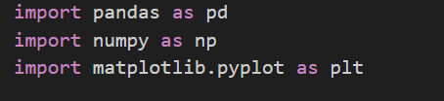
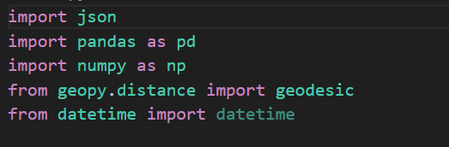
Tuesday, 16 December 2025
Go, change the world
10

Slide 11
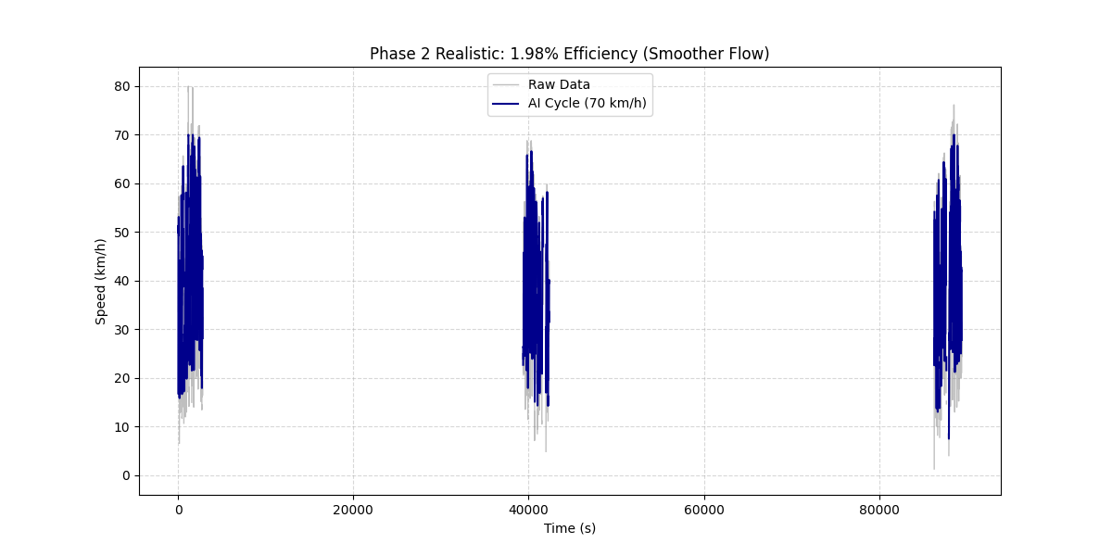
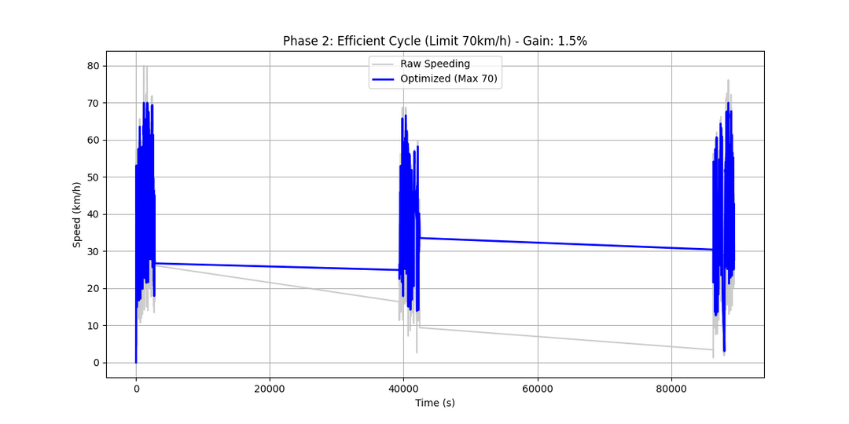
Analysis of Partial Results
The analysis demonstrates a +1.5% gain in Fuel Efficiency in Raw vs Optimized (Line Graph), alongside 1.98% gain in Fuel Efficiency in Scatter View (Anomaly Removal). With 6.0% of the trip spent in Congestion (<20 km/h), the model achieved a -2.0% reduction in Emissions (10.69 kg saved). Finally, an Accuracy RMSE of 7.74 confirms realistic optimization.
We did similar analysis with 5 datasets.
Tuesday, 16 December 2025
Go, change the world
11

Slide 12

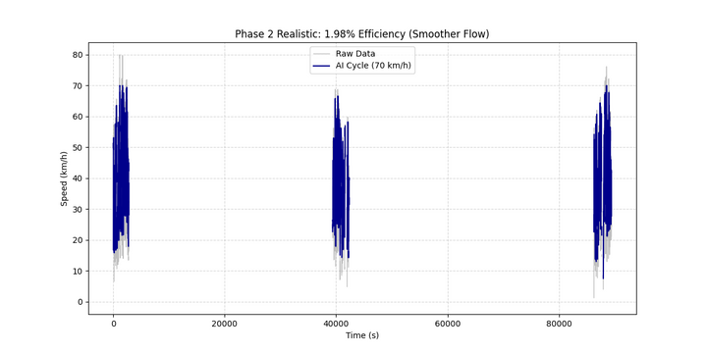
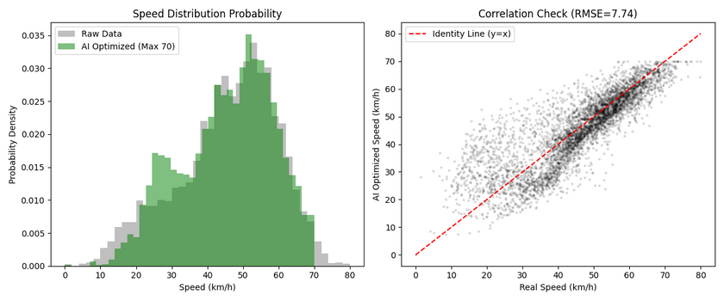
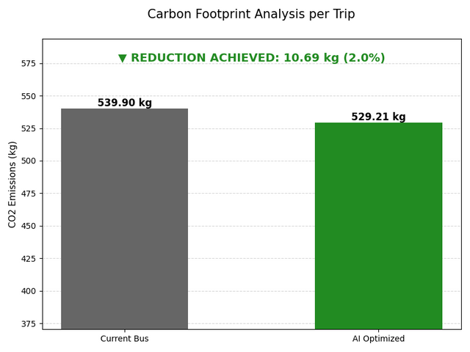
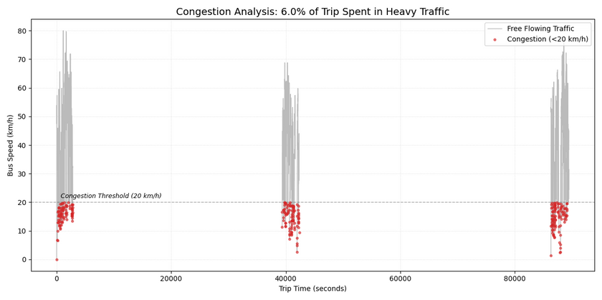
Results and Discussion
Tuesday, 16 December 2025
Go, change the world
12

Slide 13
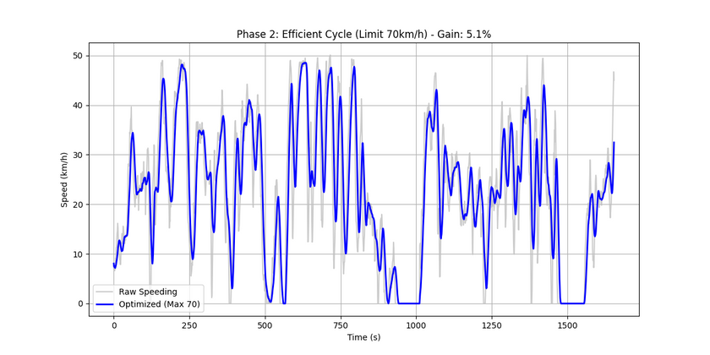
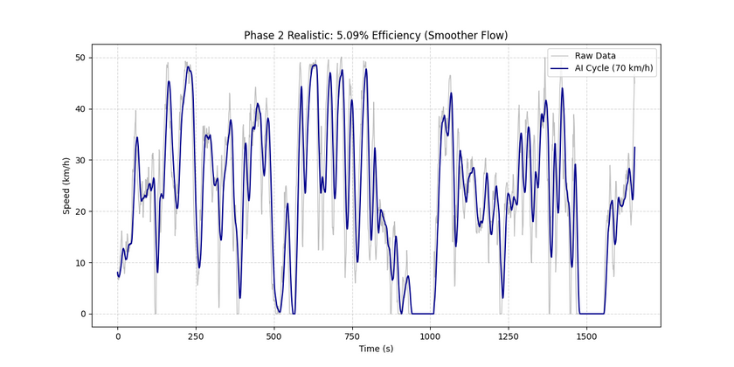
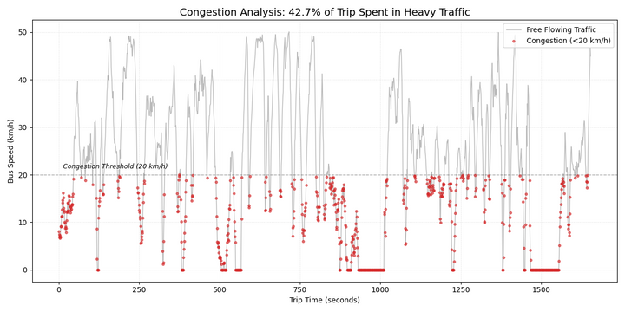
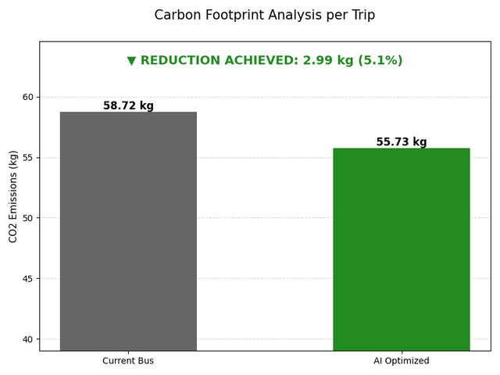
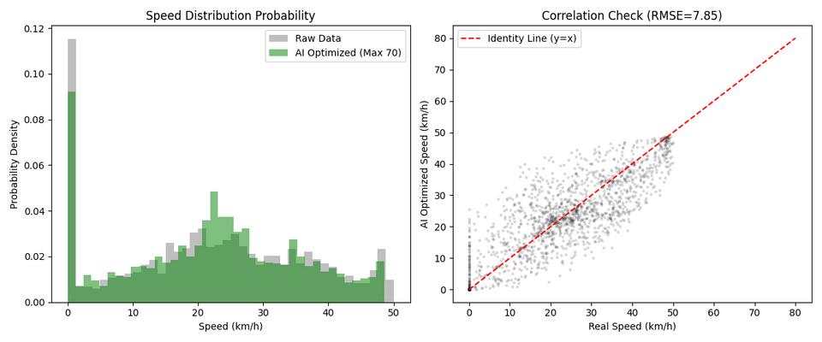
Tuesday, 16 December 2025
Go, change the world
13

Slide 14
Results and Discussion
Ahmedabad: Analyzed 5 existing datasets from the Gandhinagar corridor.
Bengaluru (BMTC): Collected primary real-world data by physically riding and logging GPS traces on 2 distinct BMTC bus routes.
Hybrid MMAS-ABC: Successfully optimized driving cycles for both Ahmedabad and Bengaluru traffic profiles.
Impact: Achieved fuel efficiency gains of 1.98% – 5.09% and reduced CO₂ emissions by
~2% – 5% per trip.
Congestion Mapping: Identified specific stop-and-go clusters (speed < 20 km/h) in real-time.
Validation: Low RMSE scores (5.31 – 8.72) confirm the model adapts well to both theoretical data and your live BMTC field tests.
Tuesday, 16 December 2025
Go, change the world
14

Slide 15
CONCLUSION
Project Summary
Goal: Reduce urban transit emissions in Ahmedabad & Bengaluru.
Solution: Built a Hybrid MMAS-ABC AI engine to smooth erratic driving patterns.
Result: Validated on live BMTC data, proving that optimized driving cycles significantly lower fuel use and CO₂ without new infrastructure.
Group Reflection
Real-World Complexity: We learned that actual traffic data is messy; adapting theory to reality was our key challenge.
Field Insight: Riding BMTC buses for data collection showed us the human side of "data points."
Tuesday, 16 December 2025
Go, change the world
15
Notes:
12

Slide 16
Outcome of the work
Paper Title "Hybrid MMAS-ABC Optimization for Sustainable Urban Bus Transit"
Core Achievement Validated fuel savings and reduced emissions using novel Swarm Intelligence on Indian roads.
Current Status In preparation for submission to peer-reviewed journals.
Tuesday, 16 December 2025
Go, change the world
16
Notes:
12

Slide 17

Tuesday, 16 December 2025
Go, change the world
17

